Slide 1

WELCOME TO
NOVA SPEKTRUM, OSLO NORWAY

Slide 2
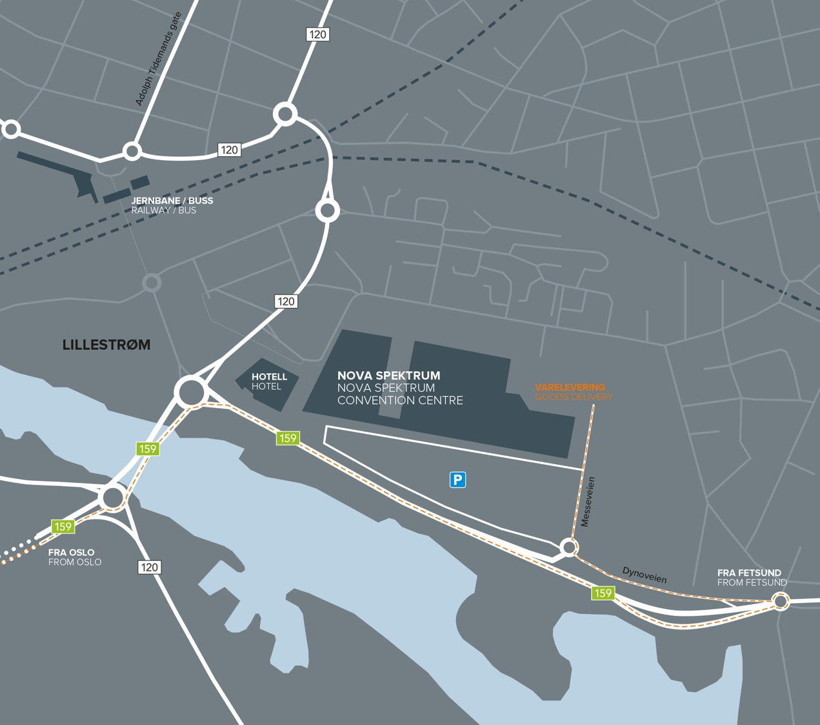

LOCATION
12 minutes by train from Oslo International Airport and 10 minutes from Oslo Central Station
5 minutes walking distance from local
train station
Two onsite hotels,
550 rooms

Slide 3
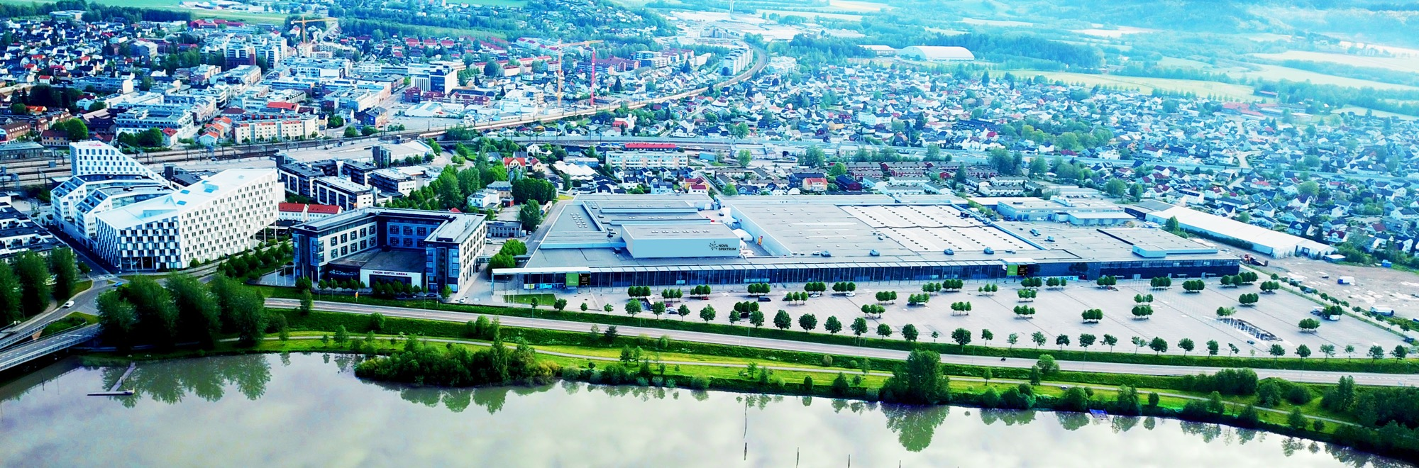
VENUE
40.000 m2 | 5 halls | 55 meeting rooms

Slide 4
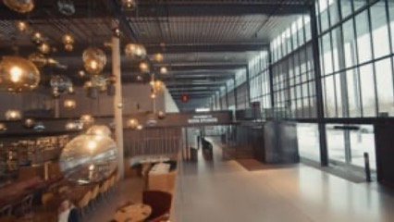
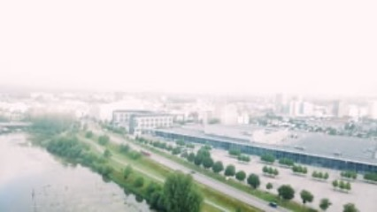
VIDEOS OF NOVA SPEKTRUM

Slide 7
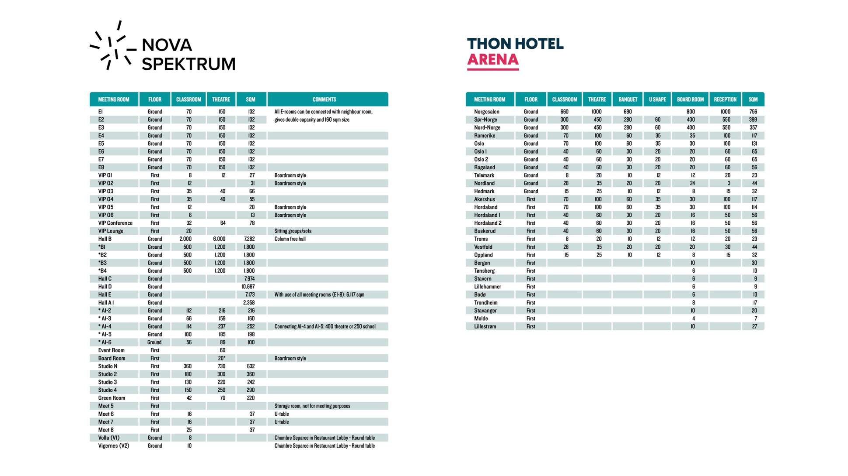

Slide 8
Short-FACTS
NOVA Spektrum, Oslo Norway
12 minutes by train from Oslo International
Airport and 10 minutes from Oslo Central Station
5 minutes walking distance from train station
40.000 sqm of exhibition and conference space,
up to 55 meeting rooms, up to 6.000 in plenary
550 onsite hotel rooms
Free high-speed wi-fi
Full service venue, supplying everything
for conferences and exhibitions
English speaking project team
Parking facilities for 2.000 cars
Excellent references from international congresses
Solid sustainability program

Slide 9
SERVICES
NOVA Spektrum with partners offers all kinds of services for your event
Certified PCOs
AV & IT
Free high speed wi-fi
Food & Beverage with individually
designed menues
Hosts and staff
Exhibitor stand design and services
Thon Hotel Arena and Scandic Hotel, 550 rooms
Electricity works
Security with first-aid competence
Alcohol servings exclusively serviced
Please find all our services in our product catalogue.

Slide 10

SUSTAINABILITY INITIATIVES
Environmental & ISO/EU certifications
NOVA Spektrum is an Eco-Lighthouse certified company.
Through digital systems, NOVA Spektrum accesses specific tools to work purposefully to improve our environmental preformance in the area of working environmental, waste management, energy use, purchasing and transport. This allowes us super conditions to contribute in achiving several of the UN s sustainability goals.
The Environmental Lighthouse scheme is operated by the Environmental Lighthouse Foundation.
Eco-Lighthouse (Miljøfyrtårn) is the first national certification scheme in Europe to have been recognized by the European Commission. The recognition proves that the scheme has a standard and quality in line with international labelling schemes (EMAS and ISO 14001)

Slide 11


SUSTAINABILITY PROGRAM AT NOVA SPEKTRUM
Oslo ranked as no 2 city worldwide
on GDS-index in 2023
Local food – preferred use of locally produced food where possible. Preferance of ecological and neutricious components. Several local suppliers.
Food waste – all food waste registered in analysis programs, supplying tool for further reductions. Food waste goal of minus 20% before 2025. All fresh food wastes given to local NGO city mission. Single packing of food preferred as alternative to buffet.
Servings – preferred serving by glass and metal solutions vs disposable products.
Supplier program – preferred use of suppliers with documented sustainability production prosess.
Cooperations – extensive use of knowledge within local authorities on developing new programs.
Renewable energy – all energy consumption based on optimally use and resirculation.
Exhibition waste – sorting and handling program based on 7 elements. Extended use of permanent materials.
Transport – visitors are recommended use of public transport to access the venue from airport and Oslo C. Agreement made allowing international congress delegates 60% discount on public transport.

Slide 12
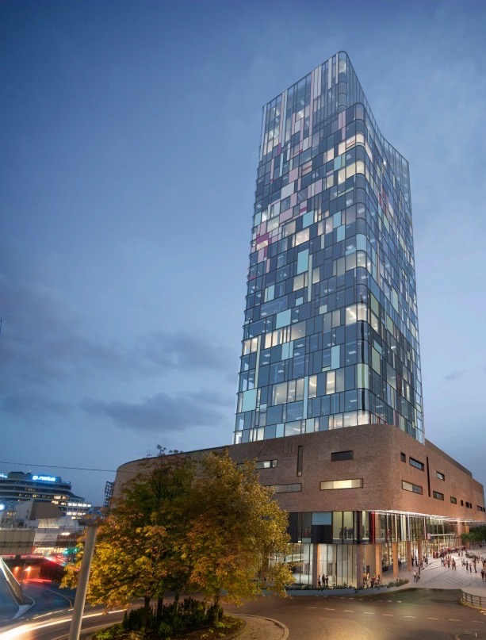
NEW CONFERENCE CENTER
Oslo Spektrum
NOVA Spektrum owns Oslo Spektrum, an event center located down town Oslo, two minutes walking distance from Oslo Central Station.
Plans of building a brand new conference center with capacity of 3000 persons is in process, with estimated opening 2028.

Slide 13
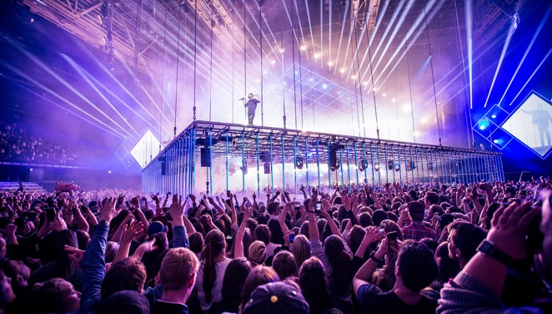
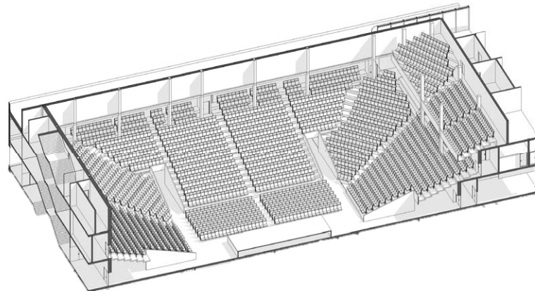
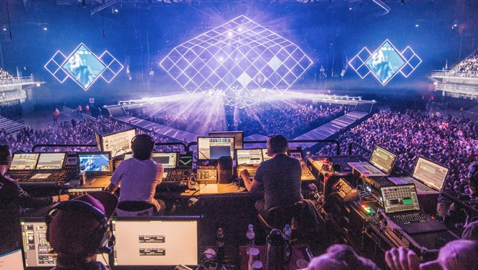
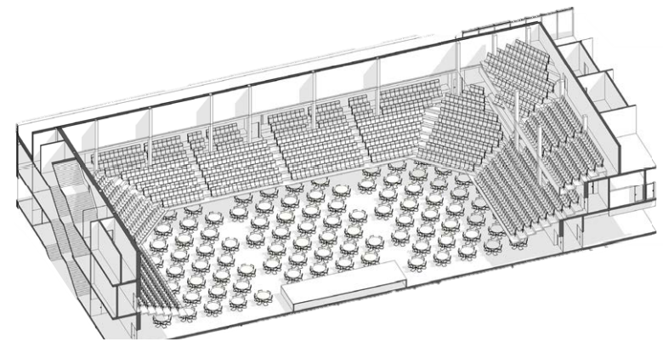
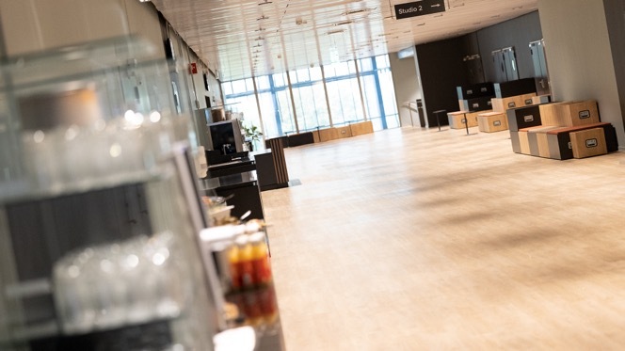
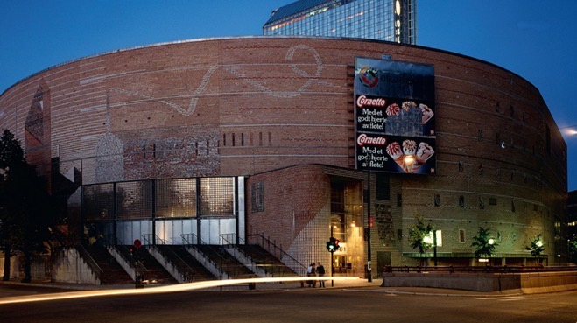

Slide 14
WELCOME TO OSLO

